Slide 1
NIEM Slides

Slide 2
What is NIEM?
Problem
Lack of standards leads to a decreased level of information sharing and increased costs associated with information exchange development.
Solution
The National Information Exchange Model (NIEM)
NIEM is a federal, state, local, tribal and private initiative to increase information sharing between organizations. NIEM includes a data model from which organizations can establish information sharing specifications.
NIEM adoption leads to cost avoidance, enhanced mission capabilities and low total cost of ownership.

Slide 3
What is NIEM?
Data Dictionary of agreed-to Terms and Definitions
Object Oriented Data Model providing components for creating Information Exchange Packages (IEP)
Set of Specifications for building NIEM components and IEPs
Governance processes and support infrastructure
Clearinghouse of reusable IEP Documentation (IEPD)
Online Web-based Tools for building IEPDs
Training, Knowledge Center, and Helpdesk
Technical Assistance for NIEM Domains and IEPD development
Program providing NIEM leadership and Management Stakeholder
Operational practitioner driven Model and Program
Partnership of local, state, tribal, and federal entities

Slide 4
What is NIEM
A National Standard that facilitates information sharing:
Across organizational and jurisdictional boundaries
Implemented across Federal, State, Local, Tribal, and Internationally
A Data Model providing:
Agreed-upon terms, definitions, and formats for various business concepts
Agreed-upon rules for how those concepts fit together
Independence from how information is stored in individual agency systems
A Structured Approach for:
Development tools, processes, and methodologies
A Vocabulary with some structure (XML, JSON, UML, YAML)
Defines format and structure of data in transit
Can be leveraged for data at rest

Slide 5
The NIEM Data Model
NIEM’s data model is a set of common, controlled, and approved XML data structures and definitions vetted through the Federal, State, Local, Tribal and Private Sectors.
Data elements are organized into core and domain-specific components
Core components are used by multiple domains and can be described by structure, semantics, and definition universally
Domain-specific components are continually updated by subject matter experts that are actual NIEM participants and industry experts for their particular domain
NIEM Naming and Design Rules (NDR) specify how each of these components are defined and utilized

Slide 6
The NIEM Model
Defines things like: objects, properties, associations & roles

Slide 7
metadata
Data about Data
Examples:
Source
Quality
Language
Reliability
Security
PII, PHI
Can be shared by multiple objects

Slide 8
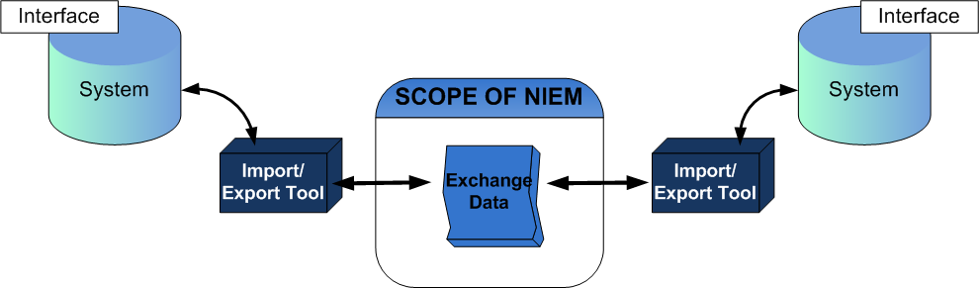
Scope of niem
NIEM is a data layer standard and intentionally does not address all of the necessary technologies needed for information sharing.
Exchange partners decide how to store and process the NIEM-conformant data being exchanged
Notes:
NIEM intentionally does not address standardizing data inside legacy systems. NIEM serves as a translation layer (providing a common understanding) between and across disparate systems

Slide 9
Why NIEM? The Fusion Center Challenge
Fusion Centers
FIG
DHS NOC
US Customs
DOD
JTTF
Port Authority
National Guard
Border Patrol
Fusion Center
Private
Partners
Private
Partners
Tribal Agency
Private
Partners
Tribal Agency
Private
Partners
Tribal Agency
Tribal Agency
Local PD
Local PD
Local PD
Local PD
Fire
Fire
Fire
State DHS
Fire
State PD
EMS
Local
FBI Field Office
EMS
Local
FBI Field Office
EMS
Local
FBI Field Office

Slide 10
What niem is
Community-Built Framework: NIEM is a grassroots initiative that was born as a best practice developed by a handful of state and local practitioners. NIEM connects communities of people who share a common need to exchange information to advance their missions.
A way of exchanging information that comprises of:
A commonly understood way to connect data to improve government decision-making for the greater good. NIEM’s data dictionary has approximately 5,000 accepted terms commonly used in an information exchange that is governed by a broad community .
A well tested and mature repeatable, reusable process for developing information exchange requirements that improves efficiency, saves time, reduces costs, and advances and fulfills organizational missions.

Slide 11
What niem is not
A system: NIEM enables the creation of standardized exchanges of information as it moves between systems across agencies.
A database: NIEM does not store information.
Software
Exclusive to law enforcement and justice: Twelve domains including international trade and family services participate in NIEM, and that number is growing to include human services and health, and more.
Exclusive to federal government: NIEM is used by all 50 states as well as local government, private industry, and internationally.
Intrusive to existing systems: NIEM allows organizations to leverage existing legacy infrastructure and move information quickly and effectively without rebuilding systems.
Unsupported: Integrated into the NIEM framework are ready-to-use methodologies, tools, training, data models and an active practitioner community.

Slide 12

Value Proposition - Interoperability
The interoperable nature of NIEM establishes:
Common Language and Vocabulary
Agnostic Implementation
Eliminates confusion by providing consistency of data definitions between agencies
NIEM does not dictate how agencies’ systems are implemented, but enables these systems to work together
Core Biographic (Department of Homeland Security)
The Core Biographic Person Identify Data Elements (CBPIDE) IEPD was created as a standard base set of person data available for reuse both within and outside of DHS
The interoperability of the Core Biographic IEPD has given components of DHS the ability to share information using common vocabulary without limiting its use by promoting a specific implementation specification

Slide 13

Value Proposition - Reusability
The reuse of IEPDs, in part and whole, within NIEM will:
Decrease Development Time
Increase Consistency
Decreases the development time for information exchanges that use similar sets of data
Allows practitioners to increase the level of consistency in data definitions across their information exchanges
Texas Path to NIEM
Completion of 28 NIEM-conformant information exchanges to serve as the foundation for statewide information sharing using NIEM
State and local organizations can reuse these 28 critical exchanges to implement systems that support these exchanges and facilitate greater information sharing
Reuse of common business data components across the 28 exchanges resulted in a high level of consistency of data definitions

Slide 14

Value Proposition - Standardization
The formalization of NIEM as a standard enables:
Large Support Community
Structured Approach
NIEM Practitioners can leverage NIEM’s large support community to decrease development time for exchanges and increase conformance
Repeatable approach that decreases the inconsistencies and duration of development
Pennsylvania JNET (Justice Network)
Converted existing data exchanges from GJXDM to NIEM, providing project and development methodology guidance on JNET message development projects
Created repeatable NIEM message development process
Contributed documentation back to NIEM community to guide future NIEM implementation efforts

Slide 15
The value of niem
The National Information Exchange Model enables…
Collaboration
Consistency
Development
Support
Brings stakeholders together through reuse and community engagement
Establishes standards for sharing and governance
Supplies tools to aid in discovery and implementation
Provides technical assistance and training
Which Lead To
Lower Development Costs
Enhanced Mission Capabilities
Common Vocabulary
Reduced Maintenance Costs
Notes:
NIEM is a joint DHS/DOJ program, initiated in 2005 leveraging the Global Justice XML data model, to promote standardization of information exchange for cross jurisdictional information sharing. When we refer to cross jurisdictional boundaries in NIEM we are referring to Federal, state, local, tribal an private industry.
The NIEM model enables:
Collaboration bringing together stakeholders through its reuse capabilities and community engagement
Consistency by establishing standards for sharing and governance
Development by supplying discovery and implementation tools
Support by providing technical assistance in the form of a helpdesk and training
All of these add up to:
Lowered cost of development
Enhanced mission capabilities
A common vocabulary providing semantic interoperability
Reduced maintenance costs

Slide 16
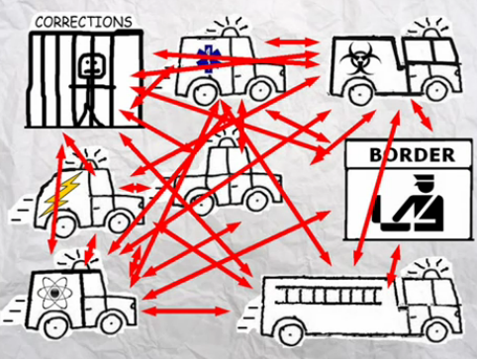
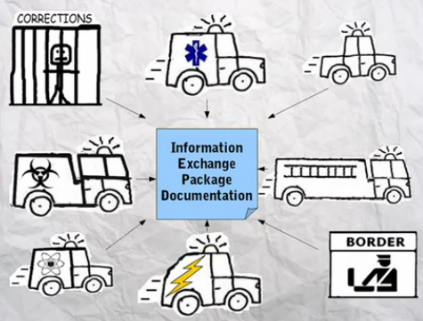
Niem connects communities
Search for NIEM Simplified on YouTube or
http://www.youtube.com/watch?v=BA1jY8LJ8tM
Without NIEM
With NIEM
16

Slide 17

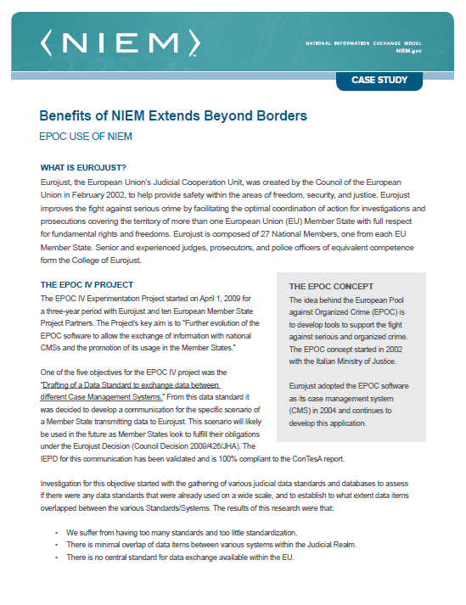
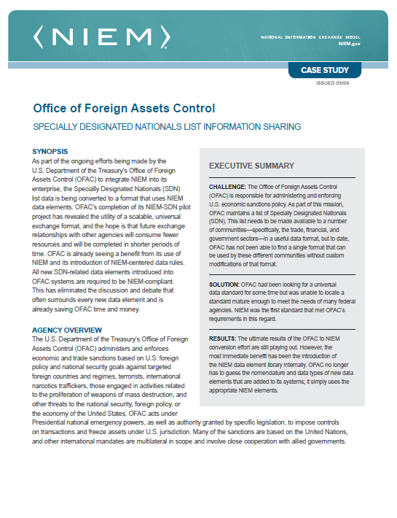

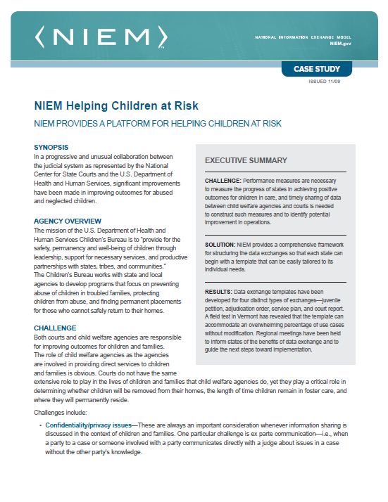
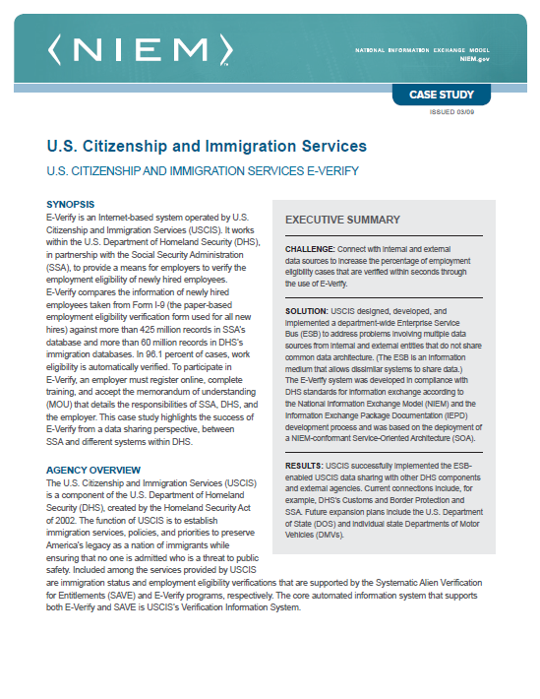


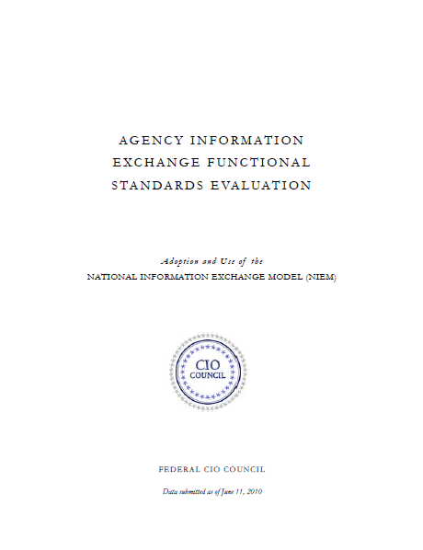
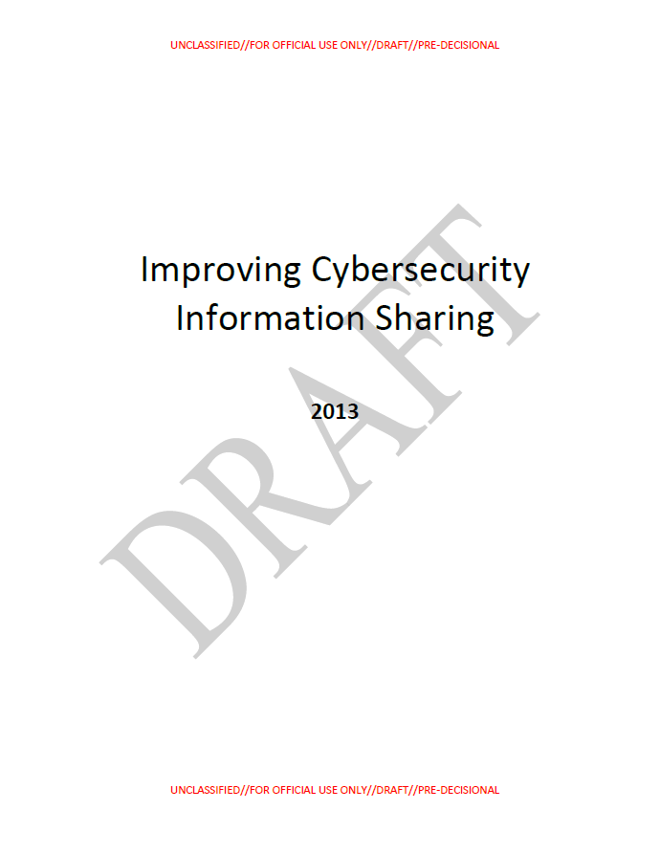
SNAP SHOT of NIEM SUCCESS Stories
More at https://www.niem.gov/documentsdb/Pages/documents.aspx

Slide 18













Unclassified
DOD Participants in NIEM
Combatant Commands
OSD /Agencies
CIO
DISA
DLA
Joint Non-Kinetic Effects (JNKE)
Missile Defense Agency (MDA)
USCYBERCOM
USPACOM
USSOCOM
NORAD
USTRANSCOM
15+ %
FY19
Growth
DHS
Military Departments
56 DoD Organizations / Agencies + DHS OCIO
USCG
USA
USMC
USN
USAF
JS (J3, J4, J6, J7, J8)
265 Participants
DOD Participation in NIEM MilOps
Unclassified

Slide 19
Dod participation
Military Departments
Joint Chiefs
Army
Navy
Air Force
Military Services
Marine Corps
Coast Guard
Combatant Commands
Cyber Command
Pacific Command
Southern Command
Transportation Command
OSD / Agencies
DoD CIO
DISA
DLA
MDA

Slide 21


Standardizing Data Across Systems
Connects communities to advance missions
Not intrusive to existing information systems
Does not require spending resources for new or different hardware
Reuses existing data elements
Enables sharing with mission partners
ENHANCE OPERATIONAL EFFICIENCY
IMPROVE INTEROPERABILITY
CONTROL COSTS THROUGH REUSE
INCREASE MISSION EFFECTIVENESS
21
Notes:
1st bullet: Proven approach

Slide 22






Current DOD IT ENVIRONMENT
Hundreds of sub-optimal data centers and networks incur unnecessary costs
Limited interoperability reduces information sharing and mission collaboration
Increasing demand for new technology on rapidly evolving devices
IT Programs average 81 Months* – cannot rapidly and efficiently field new technology to meet warfighter needs
Cyber security vulnerabilities threaten to exploit classified information and endanger our national security
Current IT delivery process hinders our ability to take advantage of new commercial technology
* Source: Defense Science Board
22

Slide 23



DoD Information sharing Needs
An information sharing approach that:
Supports Joint, Interagency & Mission Partner sharing
Aligns with whole-of-government approach
Supports the way we operate
Is data-centric
Allows agile implementation
Is easily composable and scalable
Accommodates a diverse user community
Anticipates and plans for unanticipated users
23

Slide 24
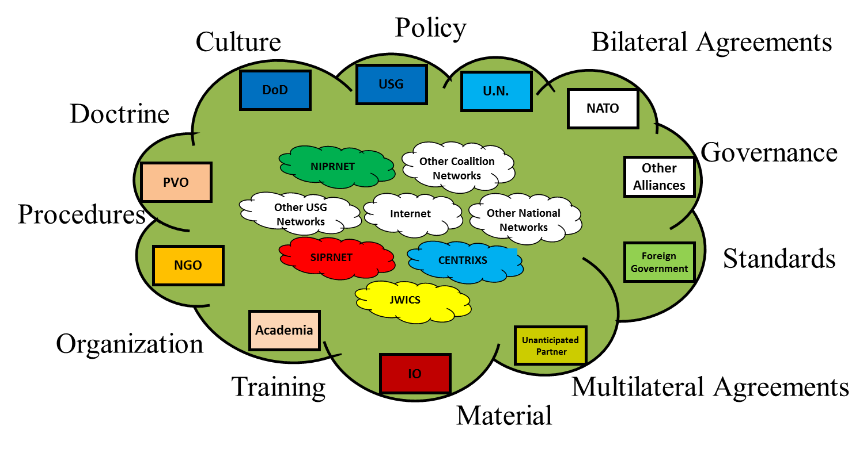
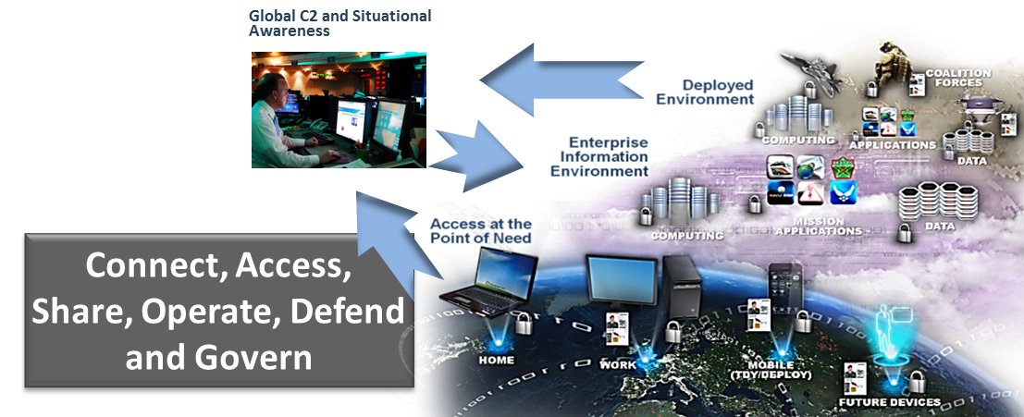
DoD Information Sharing Overview
Make Data
Interoperable
Today’s Environment
Enable Data to
Be Trusted
Make Data
Understandable
Make Data
Accessible
Make Data
Visible
Future Environment
24

Slide 25
JOINT INFORMATION ENVIRONMENT & NIEM
Bottom line: NIEM and JIE are complementary
JIE provides shared infrastructure
JIE objective is to provide the warfighter with secure access to information from any device, any time
JIE is foundational for DoD
NIEM enables content sharing
NIEM is an interoperability enabler that will leverage JIE infrastructure
NIEM provides interoperability approach, naming & design rules
NIEM provides guidance for managing data artifacts to improve information sharing
25

Slide 26
Example Ongoing NIEM Use by DOD
Military Standards
Military Messaging (MilStd 6040)
Tactical Data Link family of standards (MilStd 6016, …)
Intelligence
Navy NIEM Maritime Domain
Merchant Ship tracking (Coast Guard, Navy, Ports, UK Maritime)
Biometrics
Portable biometric readers used in Afghanistan / Iraq
Federal government biometric data sharing
Cyber
DHS-Led NIEM Cyber Domain
Joint Non-Kinetic Effects for Offensive Cyber Operations information sharing
Sensors and Control
Infrastructure protection security sensors integration
Next Generation GPS Control System

Slide 27
NIEM Implementation

Slide 28
NIEM and Implementation
In order to provide infrastructure flexibility, NIEM does not define implementation specifications
NIEM defines the format and structure of data in transit
Exchange partners decide how to store and process the NIEM-conformant data being exchanged
NIEM can be established within an organization’s Service Oriented Architecture (SOA) as a data standard for all information exchanges
Security and privacy should be key considerations when implementing an exchange

Slide 29
DHS SOA Enterprise Message Header Framework
TRANSPORT
LAYER
HEADER
JMS
IBM MQ
Tibco EMS
Oracle AQ
HTTP
SERVICE
LAYER
HEADER
SOAP & WS-Addr
Basic XML
WSDL
Service Header
Logical Model
Plain SOAP
REST
FUNCTIONAL
LAYER
HEADER
LEXS
Custom
Headers
EDXL-DE
Screening
Functional Header
Logical Model
UCore
Custom
Headers
ANSI X12 /
EDIFACT
CAMIR / CATAIR
PAYLOAD
NIEM
IEPD
EDI
Binary
XML

Slide 30
SOA and NIEM
Service Oriented Architecture (SOA) is an architectural style whose goal is to achieve loose coupling among interacting software agents.
NIEM provides the standard for data layer interoperability among services in SOA
NIEM can be used to standardize and structure the messages passed between services in SOA
NIEM can decrease development time of new services in SOA through reuse of similar IEPDs
Service Oriented Architecture
Distributed
Loosely Coupled
Standards-Based
Process-Oriented

Slide 31
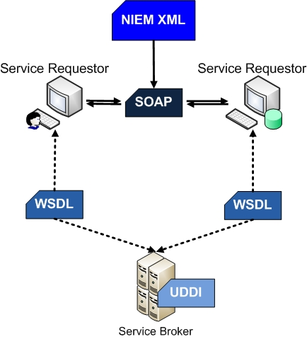
Information Exchange Implementation
NIEM XML
NIEM-conformant XML instance that contains the actual data to be shared between web services
SOAP
Simple Object Access Protocol is an XML-based protocol for exchanging messages in web services
WSDL
Web Services Description Language is an XML-based language that provides a model for describing Web services
UDDI
The diagram above represents only one of the ways to implement an information exchange
Universal Description, Discovery, and Integration is an XML-based registry of web services

Slide 32
Best Practices in Implementation
Architecture
Systems on either side of the exchange can use different implementation architectures (i.e. different programming languages, operating systems)
Consistency
All participants in an exchange must agree on the definition and structure for the data in the exchange - NIEM provides this standard
Development
IEPD Lifecycle should be used to guide development of NIEM-conformant exchange to make sure all of the necessary artifacts are created
Reuse
Elements already defined within NIEM should be used whenever possible; exchange elements outside of NIEM should also be reused whenever possible

Slide 33
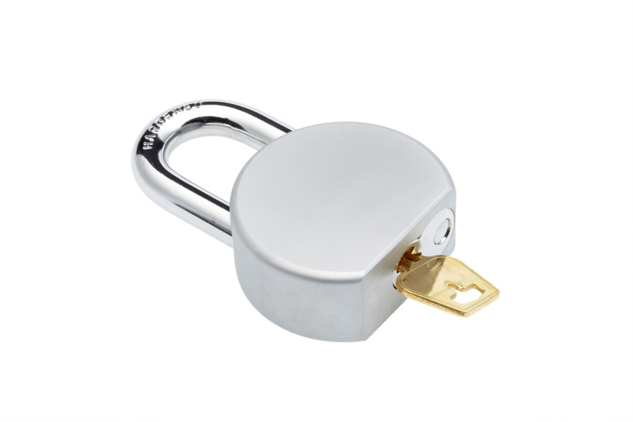

Security and Privacy
Intelligence Community Metadata Standard for Information Security Marking (IC-ISM) sets standards for security marking metadata and classified information
Metadata mechanism in NIEM 2.1 provides a method for using IC-ISM attributes
Encryption of information exchanges is not within the scope of NIEM. NIEM can be used to structure the XML before encryption
Security
Avoid transmission of sensitive or personally identifiable information (PII) whenever possible
Privacy Offices in many federal agencies set detailed standards and guidelines for the sharing of PII
Privacy

Slide 34
What is Information Sharing
A police officer pulls you over with lights flashing
The officer asks you for your license and registration
You offer
your excuses for the infraction
Information Sharing refers to the combination of policies, governance, procedures, and technologies that allow different organizations to share important data with each other.
The officer is able to run your license and pull up identifiable information about you.
To no avail, the officer walks away to prepare the ticket
Arrest Warrants
Criminal History
DMV
Missing Persons
Notes:
Information sharing requires integration with POLICY
There is a “driving need” and it is often “critical and urgent”

Slide 35
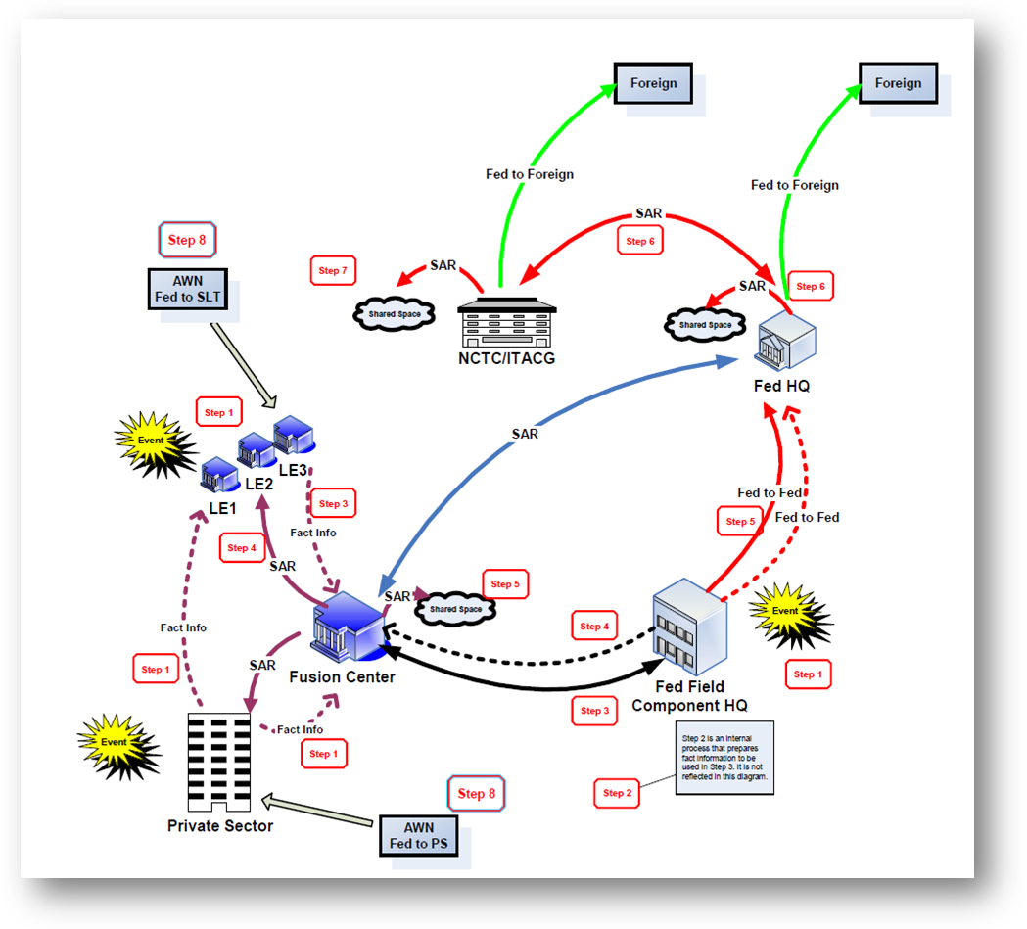
NIEM Info Exchanges in Fusion Centers
Suspicious Activity Reporting (SAR)
Notes:
This scenario for Suspicious Activity Reporting (SAR) shows the end-to-end reporting and sharing of suspicious activities from the point of observation to the point the information enters the information sharing environment. It depicts the gaps in information sharing that SAR addressed to monitor trends in suspicious activity reporting and allow authorities to respond appropriately.

Slide 36
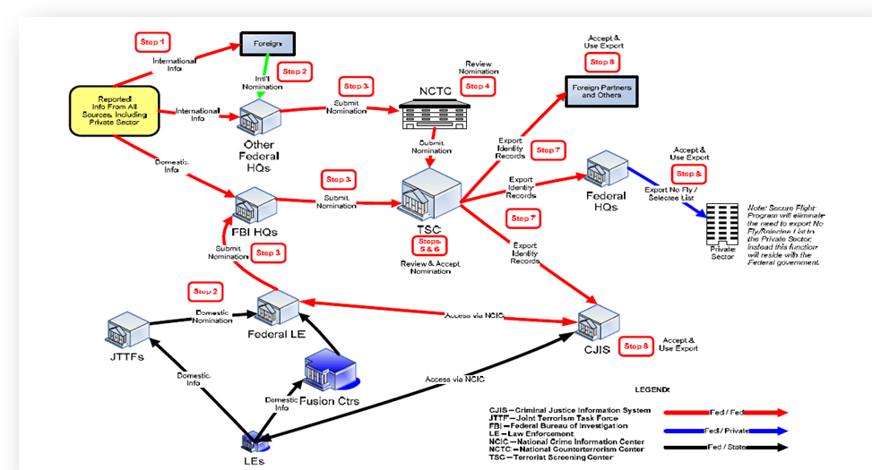
NIEM Info Exchanges in Fusion Centers
Terrorist Watchlist Person Exchange Data Exchange Standard (TWPDES)
Notes:
This data exchange standard illustrates how reported information on watchlist persons enters the information sharing environment. Upon entry into the information sharing environment, the reported information is transferred to multiple stakeholders across both the private and public sectors. This data exchange standard bridges gaps that assist authorities with the needed terrorist watchlist person data.

Slide 37
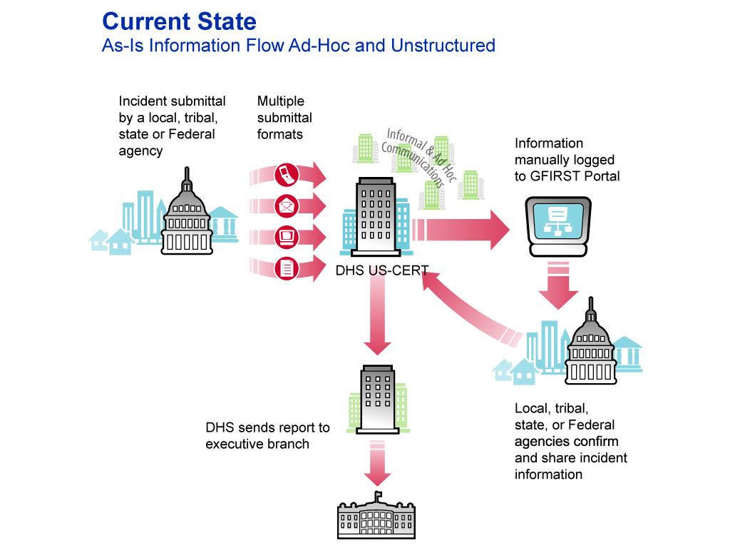
NIEM Cyber Information Sharing (future)
Roberta Stempfley, DHS NCSD Director, established NIEM Cyber in December 2010

Slide 38
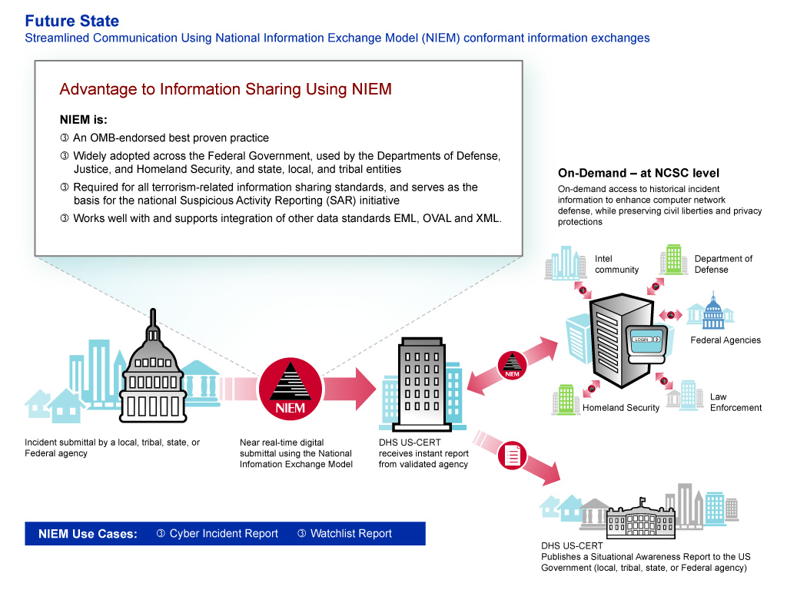
NIEM Cyber Information Sharing (future)

Slide 39
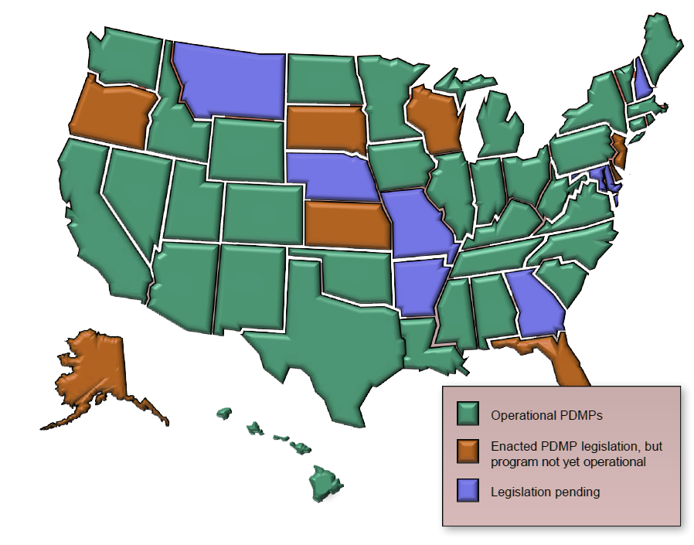
NIEM ImPACT ON pharmaceutical drug monitoring
The Prescription Monitoring Program uses NIEM to empower connections:
1,600,000 Prescribers
284,000 Pharmacists
73,000 Pharmacies 54 Boards of Pharmacy 18,000 Law Enforcement Agencies 11,000 Substance Addiction Treatment Programs
140 Consumer Protection Agencies
This is a solution that the 50 states, Canada, and Mexico can leverage.
This map identifies the status of Prescription Drug Monitoring Programs (PDMPs)
Notes:
Number of Pharmacists (http://www.bls.gov/oco/ocos079.htm)
2008 269,900
2009 274,490
2010 279,080
2011 283,670
2012 288,260
2013 292,850
2014 297,440
2015 302,030
2016 306,620
2017 311,210
2018 315,800
Number of Boards of Pharmacy (http://www.nabp.net/boards-of-pharmacy/)
Number of Pharmacies
http://oig.hhs.gov/oei/reports/oei-05-06-00320.pdf
Of the 73,398 pharmacies included in the NCPDP file, 58,768 were classified as retail.
Number of Prescribers
http://www.ncpdp.org/products.aspx
Number of Consumer Protection Agencies (sum of S&L and Fed programs)
http://www.consumerworld.org/pages/agencies.htm
Number of HHS Substance Addition Treatment Programs
http://findtreatment.samhsa.gov/

Slide 40
NIEM adds context to Data-in-Motion
Data in Motion
Place
Movement of data
Linkages to other data
Report
Business area
Time
Users

Slide 41
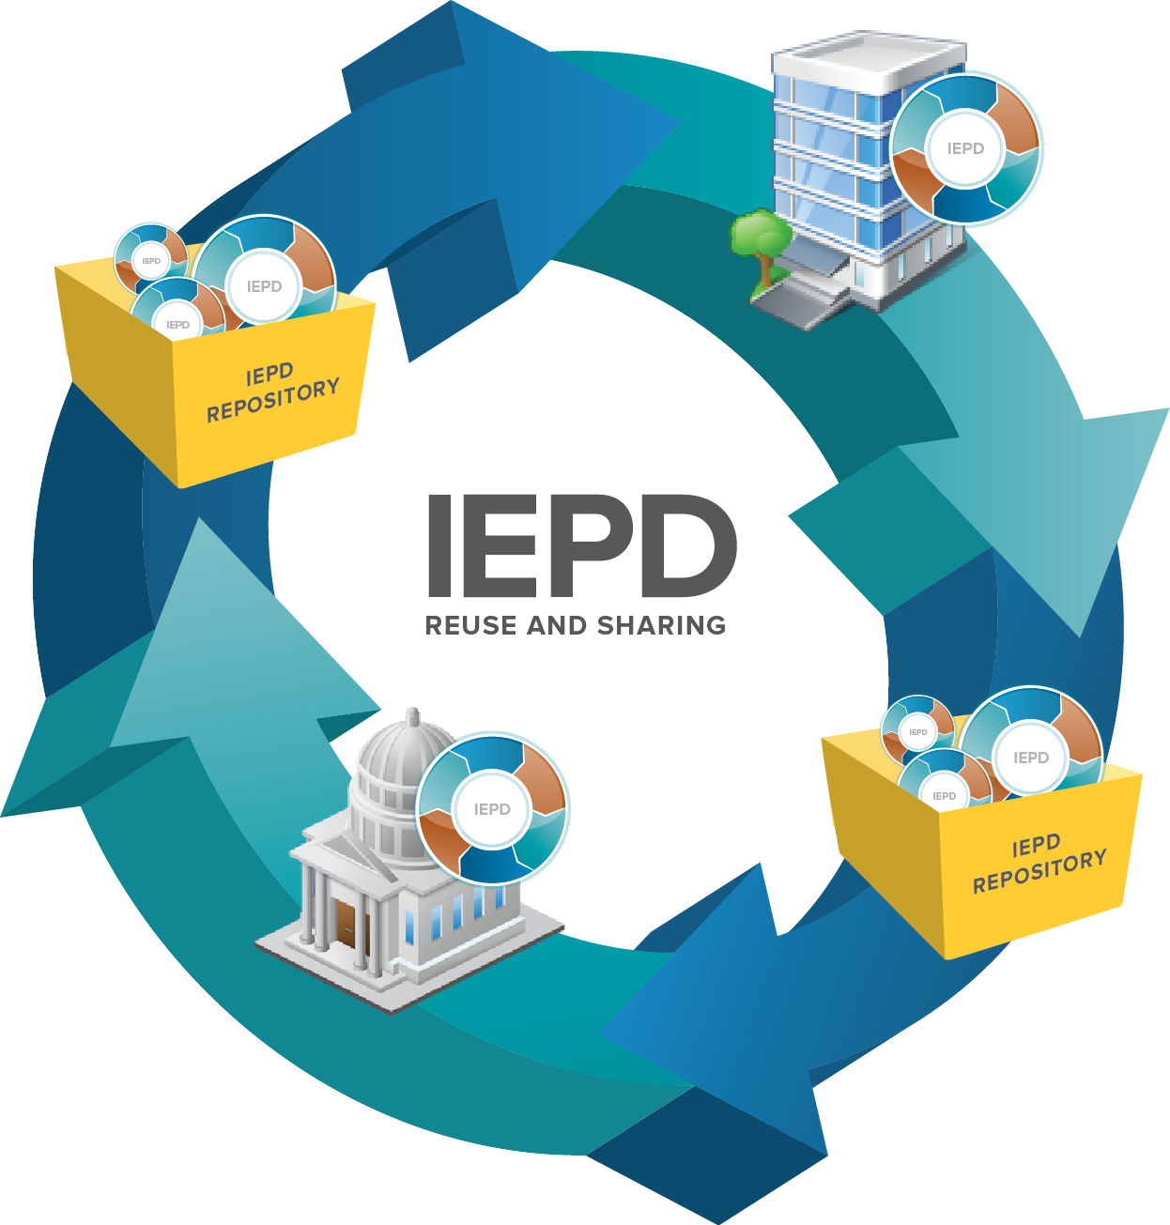
NIEM NETWORK EFFECT
Sharing NIEM Functional Specifications Saves Money and Increases Efficiency
The results of the NIEM Cost Model pilot with recovery.gov confirmed the NIEM value proposition.
The cost of developing the initial NIEM exchange was 4% higher than that of a custom XML exchange, representing a larger upfront investment.
The cost of developing additional NIEM exchanges was lower than that of custom XML exchanges:
The cost savings was 75% when using the same data as the original exchange.
The cost savings was 16% when using NIEM to develop an additional exchange with new data.

Slide 42
Systems Development Life Cycle
The Systems Development Life Cycle (SDLC) is a common methodology used for creating software
The IEPD Lifecycle integrates closely with the phases of the SDLC
Notes:
42

Slide 43
Strategic Next Steps for NIEM
Increasing NIEM international adoption (Canadian cross-border initiatives)
Broadening NIEM state & local implementations
Developing enabling standards for NIEM and the Information Sharing Environment (Object Management Group and OASIS engagement)
Institutionalizing a common privacy & security framework
On-boarding new and strengthening existing NIEM Domains
Expanding governance to support other Federal agencies

Slide 44
Establishing a NIEM domain
What does it mean to establish a new NIEM domain?
What are the criteria for deciding whether a new domain is needed?
Creating a data model focused around a mission space that is not already addressed by NIEM.
The new domain’s data model will contain data elements that do not already exist in NIEM core or in other domains data models.
Forming a community of interest (COI) comprised of stakeholders that are aligned to the domain’s mission space by virtue of affiliation, interest, or responsibilities.
New Data Elements
At least one third* of the data elements required for the planned information exchange(s) do not already exist in NIEM.
Large & Diverse COI
The community of interest for the mission space is comprised of diverse and numerous stakeholder groups.
Community of Interest
Domain Data Model
Type of Organization
The domain sponsor is a Federal entity.
Domain
Multiple Exchanges
At least four* information exchanges have been developed/will be developed.
*This is not a strict rule, but a guideline intended to guide decision making.

Slide 45
Domain Establishment Process
Identify Initial Domain Scope
Determine Initial COI
Define Domain Governance Model
Formalize Domain
Steps
Identify one or more data exchanges to form the initial scope of the domain data model. The exchanges should have:
High value to the domain mission area
Potential for high reuse
Demonstrated stakeholder need.
Identify the exchange partners for the identified initial data exchange(s).
Begin contacting exchange partners and other stakeholders across federal, state, local and tribal levels to notify them of the new domain and encourage participation in the domain.
Begin drafting domain charter.
Begin drafting domain operations and maintenance plan.
Determine the appropriate organization to steward the domain.
Determine which individual will sign the Domain Stewardship Agreement.
Complete domain value proposition document and briefing template.
Submit value proposition to NIEM PMO for feedback.
Submit value proposition to NBAC for approval.
Submit value proposition to ESC for approval.
Sign Domain Stewardship Agreement.
Artifacts*
N/A
N/A
Domain charter*
Domain operations and maintenance plan*
Value proposition document
Value proposition briefing
Domain Stewardship Agreement
*These documents do not need to be completed before the domain is formally established, but provide an important foundation for the domain.

Slide 46
Agency Roles and Expectations
Perform Research
Conduct Stakeholder Interviews
Perform NIEM Readiness Assessment
Quantify & Qualify Value of NIEM
Develop a Roadmap
Weeks 1-5
Weeks 6-10
Weeks 11-12
Hold kickoff session with NIEM PMO
Connect NIEM PMO with PMs & TAs (see below) that can provide information about discrete information sharing and exchange activities (current/potential)
Provide input and direction as needed.
Estimated LOE: 1-5 hours
Provide input and direction during an in-person checkpoint with the NIEM PMO.
Estimated LOE: 1-2 hours
Review and validate roadmap with NIEM PMO.
Provide feedback and determine next steps.
Estimated LOE: 1-2 hours
Sponsor
Provide information about mission objectives, current information exchange activities, and information sharing environment
Participate in a guided interview and respond to NIEM PMO questions.
Provide potential POCs
Estimated LOE: 2-4 hours per PM per week **
Respond to questions from the NIEM PMO, as needed.
Estimated LOE: 1-2 hours per PM per week
Respond to questions from the NIEM PMO, as needed.
Estimated LOE: 1 hour per PM
Program
Manager (PM)*
Provide information about LOE and costs associated with exchange development and implementation.
Participate in a guided interview and respond to NIEM PMO questions.
Estimated LOE: 2-4 hours per TA per week **
Respond to questions from the NIEM PMO, as needed.
Estimated LOE: 1-2 hours per TA per week
Respond to questions from the NIEM PMO, as needed.
Estimated LOE: 1 hour per TA
Technical
Architect (TA)
*One or more program managers/other equivalent POCs may be needed to provide information about different exchanges.
** The actual level of effort to complete the required tasks may be lower than initially estimated.

Slide 47
Domain Stewards
Domain stewards play a critical role in the success of a domain by managing domain activities, driving domain growth, and interfacing with NIEM governance bodies. Domain Stewards must be Federal entities. The Domain Stewardship Agreement must be signed be an individual with funding authority.
Domain Steward Responsibilities
Governance
Participate in NIEM governance committees (NBAC, NTAC, and others, as required).
Encourage grassroots domain growth by:
Engaging the COI in domain activities
Providing channels for wider stakeholder feedback
Bringing new stakeholders into the community
Identify a point of contact to field help-desk inquiries for domain-specific issues.
Technical
Manage and maintain the domain data model, including providing clear definitions and metadata for each data element in the domain.
Support domain harmonization, reconciliation, and synchronization as needed.
Complete all required domain artifacts, as specified in the DSA and relevant specifications.
Operational
Communicate cross-domain needs and highlight domain successes.
Promote the implementation and development of conformant IEPDs within the domain.
Track and report technical issues raised by the domain community.
Validate that sufficient resources are in place to support the domain.

Slide 48
Domain Establishment
The key to establishing a successful domain is focusing on not just the data model but also the represented exchanges and communities of interest.
I: Identify Business Exchange
II: Stakeholder Engagement
III: Formal Domain Creation
Value:
Align to strategic mission priorities
Determine high value exchanges that will have substantial reuse
Supports identification of communities of interest (COIs)
Supports coordination with other data standards
Engages stakeholders interested in the specific scope selected
Allows the domain to respond dynamically to user needs and changes
Supports early governance establishment
Grassroots adoption gains momentum
Define the value proposition of the new domain
Coordinate with the NIEM PMO
Access to new sharing partners
Access to already existing exchanges and domains
Initial domain scope identified
Establishment of COI and participation in the NIEM community
Formal ESC recognition of domain and COI
Results:

Slide 49
Identify Business Exchange
An agreed-to business exchange or mission need will drive the future phases of domain establishment, providing initial model scope, as well as identifying the community of interest that should be engaged.
I: Identify Business Exchange
II: Stakeholder Engagement
III: Domain Creation
Step
Description
Identify Candidates
Identify candidate information sharing scenarios that will drive the initial scope of a new domain. These scenarios should align with strategic mission priorities, have the potential for substantial reuse, and demonstrate relevance to stakeholder business needs.
Gather Business Documentation
Document use cases for information exchange. This includes gathering functional and technical requirements around business exchanges, and fully understanding the context of the information sharing to occur.
Determine Overlap with NIEM
Look at the data involved in the information sharing scenario and determine any overlap with existing NIEM content. That which is not already included in NIEM is a strong candidate for the initial scope of the new domain.
Develop Initial Domain Model
Commit to the initial scope of the domain, developing a model that represents that content. This is where integration and collaboration with existing standards can be defined.

Slide 50
Stakeholder Engagement
The establishment of a COI is essential to the long-term success and continued maturation of a domain.
I: Business Exchange
II: Stakeholder Engagement
III: Domain Creation
Step
Description
Identify Stakeholders
Identify organizations and key participants who have an interest in the exchange being used for the initial scope to participate in the domain Community of Interest (COI). This should include both technical and business resources.
Define Initial Governance and Operations
Based on the needs of the domain and the COI, establish an initial governance structure and plan for managing and maintaining the model. This may include monthly COI calls, etc. The NIEM PMO can provide guidance and best practices around what has worked for other communities.
Monitor and Measure
Communities evolve and mature over time. Objectives may alter, members may change. It’s common for subgroups to form within a community which focus on specific topics or ideas (ex: Codelist Management)

Slide 51
Domain Creation
A formal recognition process exists so that all domains are consistently established and set up for success within the NIEM community.
I: Stakeholder Engagement
II: Business Exchange
III: Domain Creation
Step
Description
Complete Domain Scope Proposition
Complete an initial Scope Definition document and submit to NIEM PMO. Topics defined include scope & objectives, people & resources, exchange scenarios, and sample data model.
Review Scope with NIEM PMO
NIEM PMO and domain candidate review the initial scope documentation. Discussion surrounds why creation of a new domain is necessary or if there is significant overlap with an existing domain.
Present to NBAC & NTAC
The domain candidate attends a NBAC & NTAC meeting to present its value proposition.
Gain ESC Approval
ESC reviews the domain value proposition and formally issues a decision. After domain approval, Office of General Counsel (OGC) reviews domain steward ship agreements (DSA).
Source: NIEM Domain Guidebook Appendix A
Source: NIEM Domain Guidebook Appendix A

Slide 52
Domain Adoption Resources
Domain Guidebook
Community of Interest (Appendix A)
Domain Communication (Section 2.2)
Domain Readiness Assessment (Section 3.1)
Domain Update Tools
Document Templates (Domain Stewardship Agreement, Readiness Assessments, etc)
Core Capabilities Document

Slide 53
Post-Establishment Domain stand-up
Within six months of formally establishing the domain, the domain steward should ensure that the following activities are completed:
Governance
Stakeholder Engagement
Data Model
Complete domain charter*.
Complete domain operations and maintenance plan*.
Assign individuals to carry out governance and operations responsibilities, including identifying a NBAC representative.
Hold initial governance group meeting.
Develop a plan of action and milestones for remaining domain stand-up activities.
Notify the initially identified domain stakeholders that the domain has been established and inform them of any upcoming domain activities.
Work with the NIEM PMO to create a domain collaboration zone on NIEM.gov, which provides a forum for domain members to exchange ideas and post relevant documents.
Consider promoting NIEM training opportunities to the domain’s COI.
After the IEPDs for the initially identified data exchanges have been developed, create the domain data model using the data elements that did not already exist within NIEM core or other domains.
Publish the data model to publication.niem.gov*.
*The NIEM PMO will provide templates for these documents.
*Note that domains can publish their domain data models independently of overall NIEM releases.

Slide 54
Resources
The following resources provide additional guidance on completing the domain establishment activities.
Governance
Guidance on Establishing Domain Governance – Provides detailed guidance on how to stand-up a domain governance model. Domains are advised to read this document before drafting their domain charters and domain operations and maintenance (O&M) plans.
Domain Charter Template – Provides a standard format and guidance for creating a domain charter.
Domain O&M Plan Template – Provides a standard format and guidance for creating a domain O&M plan.
Stakeholder Engagement
Domain Community of Interest Guidance– Planned for development by the NIEM PMO.
Domain Stakeholder Communications Guidebook – Planned for development by the NIEM PMO.
Data Model
NIEM Naming and Design Rules (NDR) – Provides detailed design rules on how a domain data model should be structured.
Model Package Description (MPD) Specification– Defines terminology, identifies required/optional artifacts and metadata, specifies normative rules, schemes and syntax, and provides non-normative guidance.
NIEM Training available at: https://www.niem.gov/training

Slide 55
How does NIEM realistically scale to support the accelerated interest and adoption of NIEM by 26 Federal agencies, a myriad a programs within those agencies, increasing state, local and tribal interest and adoption, and lest we forget
rapidly growing international interest and adoption?

Slide 56


North America Day Public safety Pilot
Public Safety Pilot WG
Lead: Rosanna Di Paola, CIO PS
Technical Demonstration
Standardized exchange of stolen vehicle information between US, Canada, and Mexico
Partners include
USA Nlets, Department of Homeland Security, Department of Justice
Canada Public Safety Canada, Royal Canadian Mounted Police, Edmonton Police Service
Mexico Mexican Public Security Ministry, Mexico Ministry of Public Administration
Interpol

Slide 57




niem impact on cyber security
NIEM as a Solution
NIEM brings together security operations across governments, agencies, industry, and academia.
NIEM-based standards will increase coordination with several external organizations including CERN, NCCIC, MS-ISAC, IT-ISAC.
Responsiveness can be increased by eliminating the need to package and reformat crucial incident information.
Organizations can automate their use of incident reports to meet their needs and allow analysts to spend more time protecting their systems.
Using NIEM, information can rapidly be exchanged and understood with authorized parties.
Streamlined Communication Using NIEM Conformant Information Exchanges
Decreased from 7-10 days to instant
Improved efficiency
Errors reduced from 25% to less than 1% (based on other NIEM implementations)
Efficiency results in overall savings
57

Slide 58



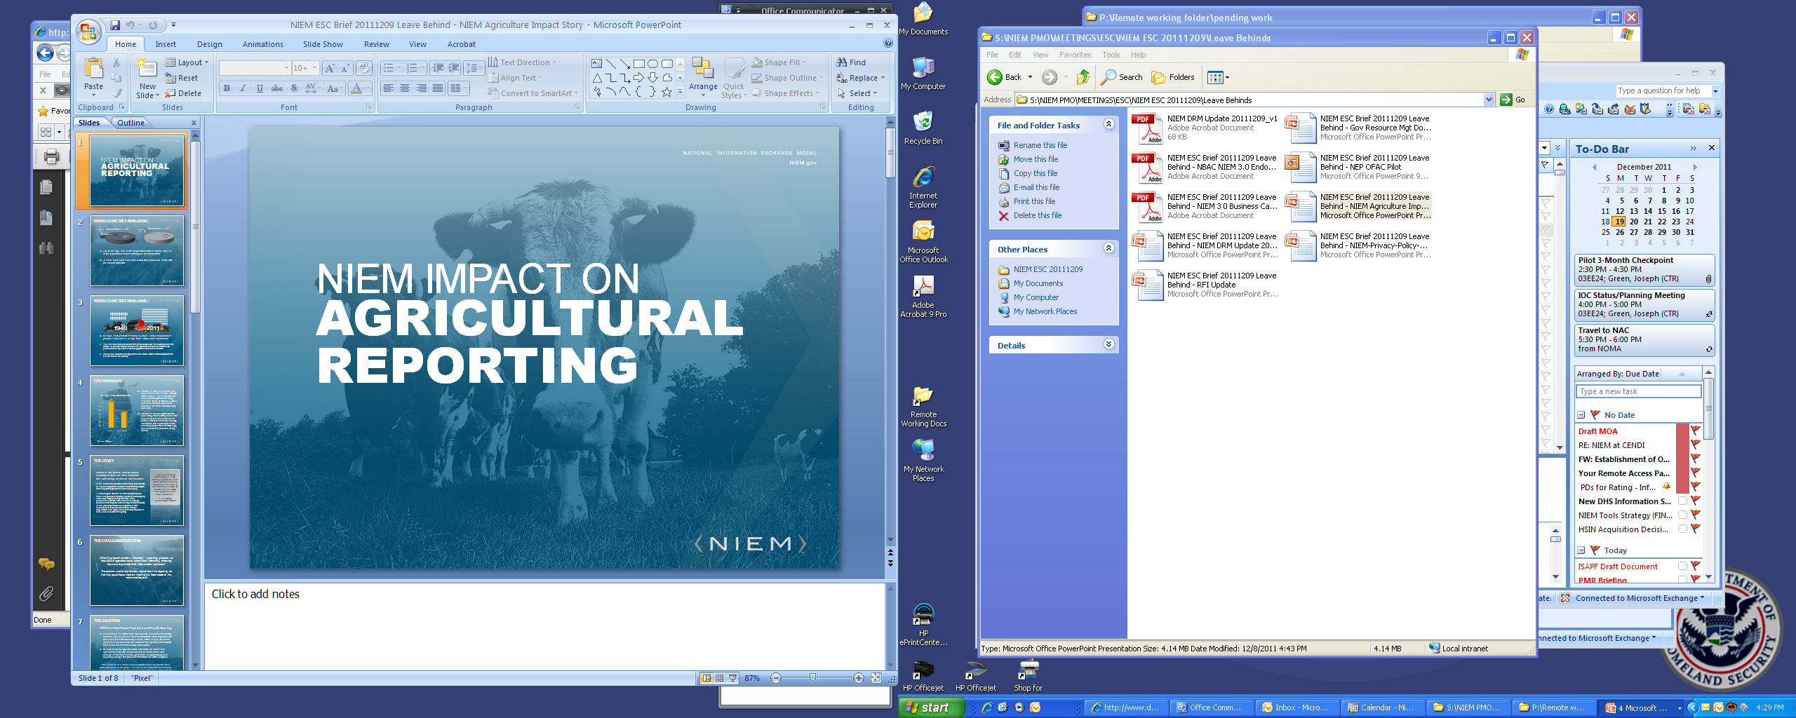
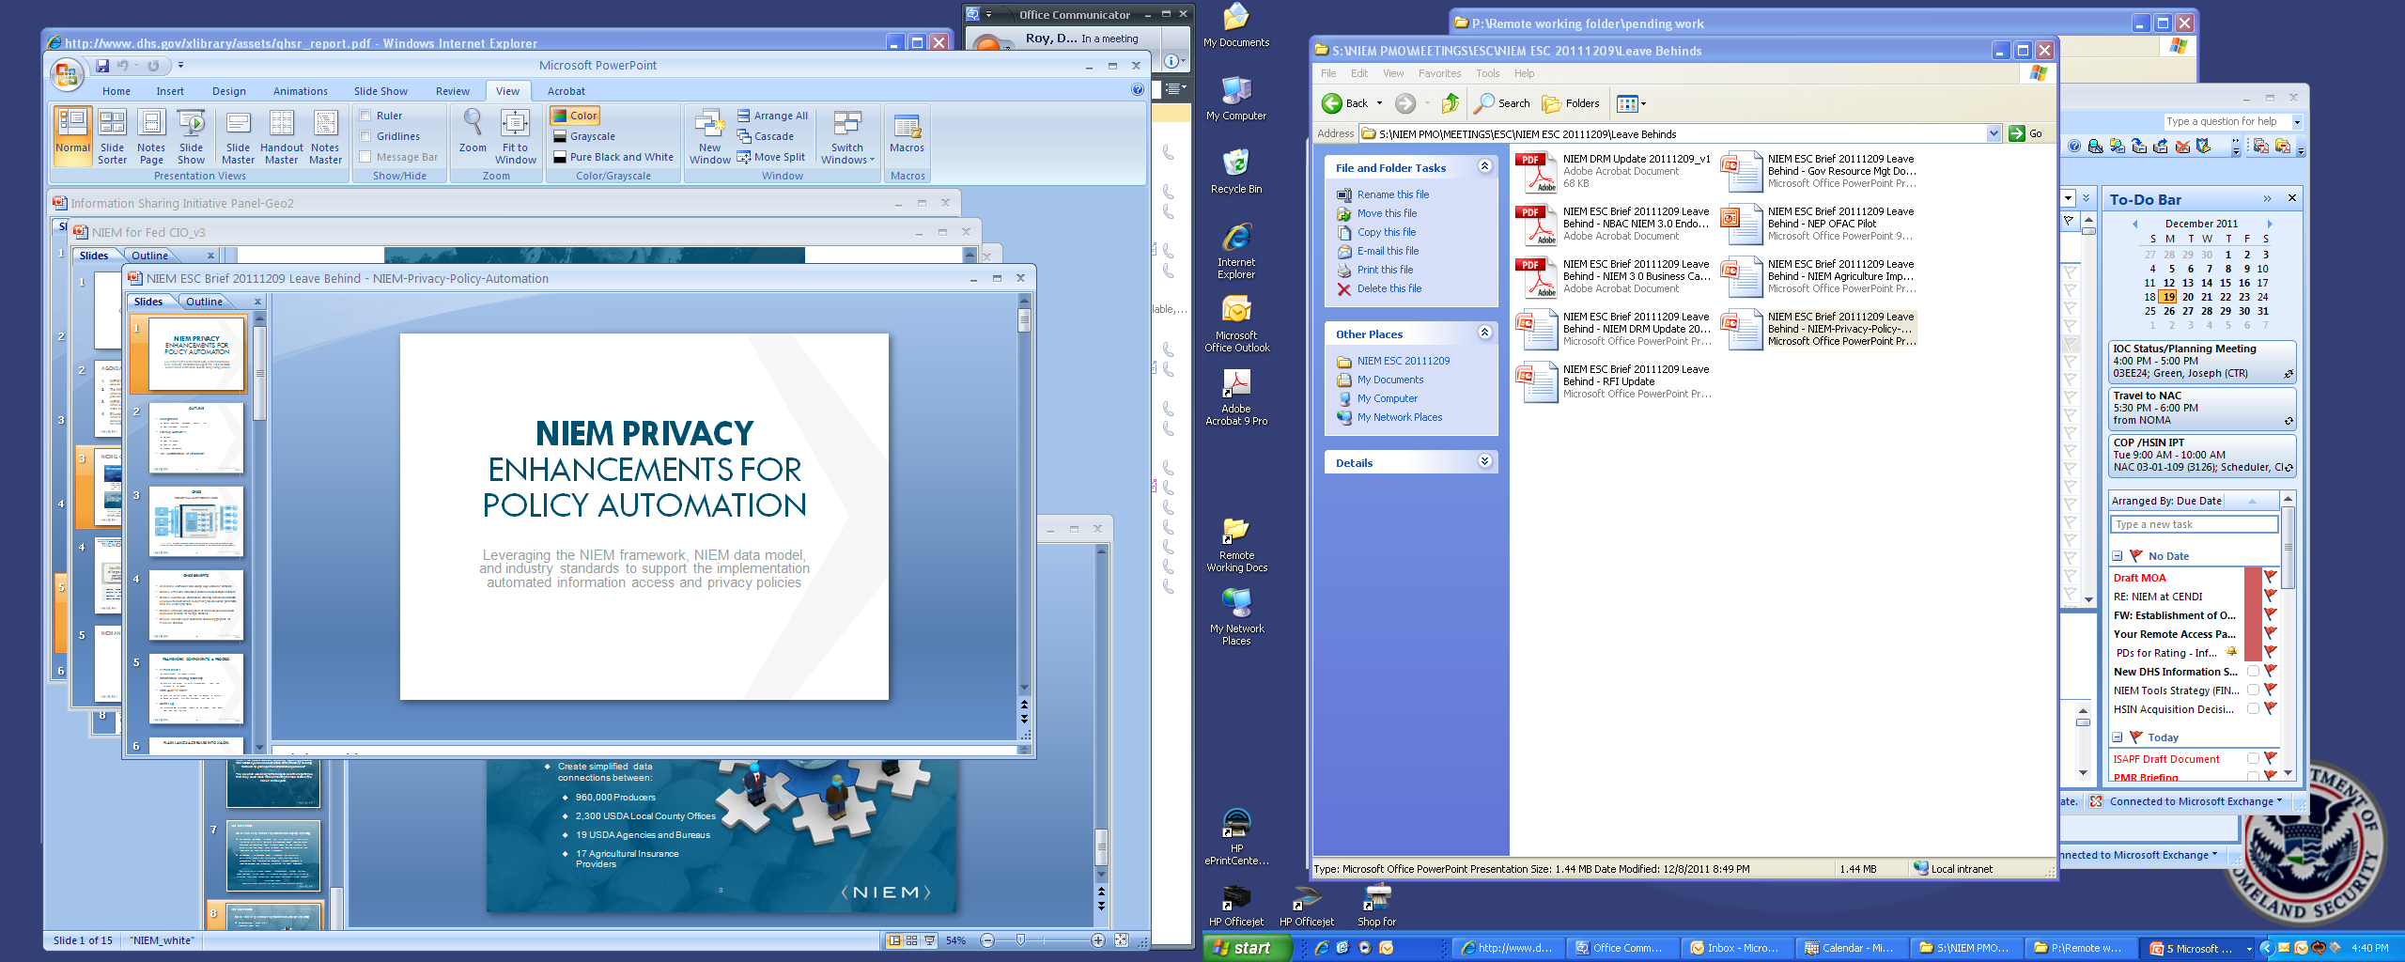

NIEM Connects Communities
Amber Alerts: A child goes missing every 40 SECONDS in the U.S., over 2,100 per day.
Prescription Drug Monitoring: 1 in 5 teens are abusing prescription drugs to get high.
Cyber: In 2010, Stuxnet halted the nuclear development capability of an entire country.
Agricultural: In 2011, the technology used to produce 20% of the GDP is more advanced than systems used for reporting to the US Govt.
Privacy and CRCL: Current controls for protecting U.S. Person data are inadequately implemented.
Requests for Information: RFI lacks common processes making intelligence collection for partners a daunting task
connects communities of people who share a common need to exchange information in order to advance their missions.

Slide 59
Why NIEM?
NIEM is a repeatable, reusable process
Information exchanges developed using NIEM, result in reusable artifacts that reduce future development costs
NIEM provides business documentation allowing ease of implementation & requirements being fulfilled
Greater agility and efficiency in satisfying business needs
Standardization on a common platform with robust governance

Slide 60
Recovery.gov
Cost Model Pilot Summary
Notes:
60

Slide 61
Introduction
Objective: The purpose of the Cost Model Pilot with Recovery.gov was to validate the results of the cost model against the NIEM value proposition.
Background: The NIEM value proposition states that adopters of NIEM face greater upfront costs (due mostly to additional training) compared to developing traditional exchanges, however with the development of multiple exchanges over time and by taking advantage of opportunities for re-use, the overall lifecycle of NIEM should offset the additional upfront costs, and provide cost savings over developing traditional exchanges Three Information Exchange Package Documentation (IEPDs) were developed for the Recovery.gov effort and those three IEDPs serve as the test case for this pilot.

Slide 62
Recovery.gov Inputs & Assumptions
Below are the high level assumptions and inputs used in the pilot:
Number of exchanges: 3
Number of additional systems consuming data exchanges: 100
Complexity: Complicated
Training costs: $0
Number of elements that exist in the NIEM model: <50%
IEPD reuse: No
Labor Rates:
SME: $120
Architect: $100
Technical Analyst: $75

Slide 63
Sample Scenarios
Scenario | Cost Category | NIEM Cost | Custom XML Cost | % Savings Over Custom XML Cost
A | Initial Exchange | $278,950 | $268,400 | (4%)
 | Additional Exchange (re-use of initial exchange) | $41,800 | $166,500 | 75%
 | Additional Exchange (no re-use) | $211,188 | $250,400 | 16%
B | Initial Exchange | $182,300 | $268,400 | 32%
 | Additional Exchange (re-use of initial exchange) | $35,300 | $166,500 | 79%
 | Additional Exchange (no re-use) | $137,850 | $250,400 | 45%
C | Initial Exchange | $171,350 | $268,400 | 36%
 | Additional Exchange (re-use of initial exchange) | $35,300 | $166,500 | 79%
 | Additional Exchange (no re-use) | $132,400 | $250,400 | 47%
Scenarios:
Scenario A: No existing IEDP. Less than 50% of elements exist in NIEM
Scenario B: Existing IEPD. Less than 50% elements exist in NIEM
Scenario C: Existing IEPD. More than 50% elements exist in NIEM
Cost Categories:
Initial exchange is the cost to create initial (first) NIEM exchange.
Additional Exchange (re-use of initial exchange) is the cost to re-use the initial exchange to share information between an additional and/or new system.
Additional Exchange (no re-use) is the cost to develop new a NIEM exchange( after having developed the initial exchange), assuming no new staff training is needed; potential re-use of the initial exchange(s) is limited.

Slide 64
Recovery.gov Actual Results (costs)
The scope of the Recovery.gov effort included the development of three NIEM exchanges to be used across 100 additional systems. The cost model estimated an overall cost savings of $12,537,875 (72%) for the use of NIEM over custom XML development in Recovery.gov.
Development of 3 IEPDs | NIEM | Custom XML | Savings | % Savings
Initial Exchange (X) | $278,950 | $268,400 | ($10,550) | (4%)
Additional Exchange (no re-use) (Z) | $211,188 | $250,400 | $39,212 | 16%
Development Cost (X+Z+Z) ¹ | $701,326 | $769,200 | $67,874 | 9%
IEPD Re-use across 100 systems | NIEM | Custom XML | Savings | % Savings
Re-use of the three exchanges across one systems (Y) | $41,800 | $166,500 | $124,700 | 75%
Re-use of the three exchanges across 100 systems (100*Y) | $4,180,000 | $16,650,000 | $12,470,000 | 75%
Total Cost (develop 3 exchanges and re-use across 100 systems) ² | $4,881,326 | $17,419,200 | $12,537,875 | 72%
¹ The Recovery.gov effort included the development of three IEPDs (one initial exchange [X]; and two additional exchanges with no re-use [Z])
²This accounts for the cost develop the three exchanges (X+Z+Z) and reuse them across 100 additional systems (100*Y). The high degree of savings (72%) is largely due to the high number of systems consuming the exchanges

Slide 65



Additional NIEM Resources
NIEM.gov contains a collection of essential NIEM documents
Introduction to NIEM
Concept of Operations
User Guide
NIEM Naming and Design Rules
Many other documents
Many resources are available to provide support and assistance
NIEM website offers recorded sessions and lecture material
NIEM Training is Available
National Information Sharing Standards (NISS) Knowledge Base and Help desk
Lifecycle artifact templates
Subset Schema Generation Tool & Graphical Browser (NIEM Tools)
Exchange Repositories
NIEM.gov IEPD Repository
DHS Data Architecture Repository (DAR)
DOJ IEPD Clearinghouse

Slide 66
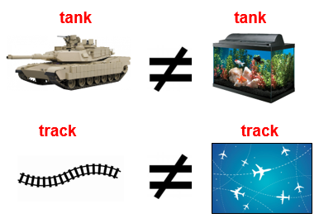
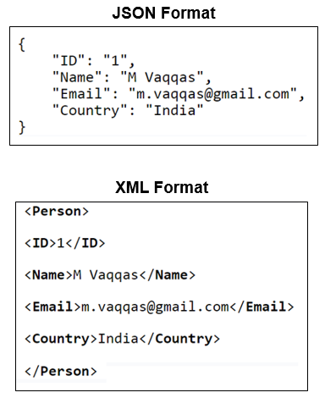

“Interoperability”
Interoperability is defined by IEEE as “the ability of two or more systems or components to exchange information and to use the information that has been exchanged.”
Interoperability is achieved by adhering to common standards and/or using a gateway to translate one system’s information to another format.
Syntax
Semantics
Structure
Notes:
SYNTAX: Although the same data is represented in three different syntactical formats, none are interoperable w/ each other. A computer program designed to read one format would not understand the same data in either of the other two formats unless additional interfaces were developed to support them.
SEMANTICS: Although the graphical comparisons are laughable to a human; computers cannot discern the meaning of one string (e.g., tank vs. tank) from the other unless humans program them to. A computer program designed to recognize an aircraft track will not likely understand a rail road track.
Most people will recognize a 10 digit phone number. However, how do you discern which is a home, work or cell phone number. The same is true for an email address. Some people will know that “mail.mil” is a Department of Defense mail exchange, but not everyone will. Furthermore, some people use their “gmail” accounts for work. How does a computer know? The same can inferences may be applied to a mailing address as well.

Slide 67
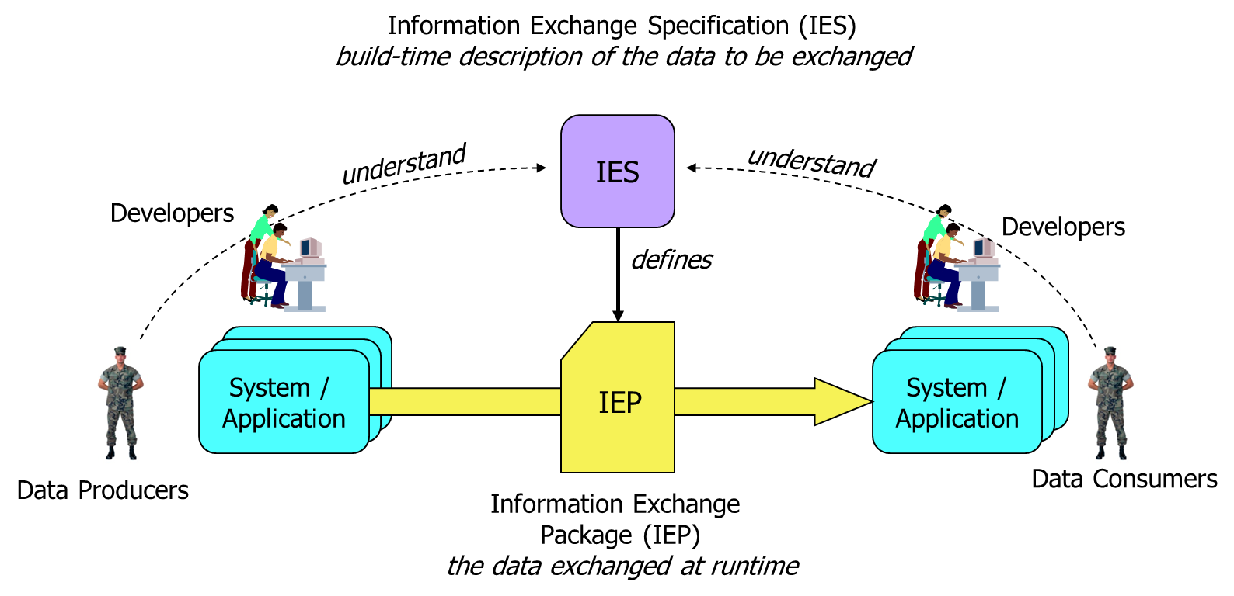
Data Interoperability OV-1
Notes:
For machine-to-machine data interoperability, there are software developers who build applications on behalf of producers and consumers. They work from an information exchange specification, a build-time description of the data to be exchanged at runtime. If they do their jobs right, then the data produced at one side will be properly interpreted at the other, and everyone will be happy.
IES – Represents a reusable technical specification defining the structure and business rules for the data being exchanged. NOTE: In NATO an Information Exchange Requirement (IER) is the equivalent of the IES in this diagram, and the Information Exchange Specification (IES) is the solution implementation of an IER.
IEP – Is an instance of the data being exchanged.

Slide 68
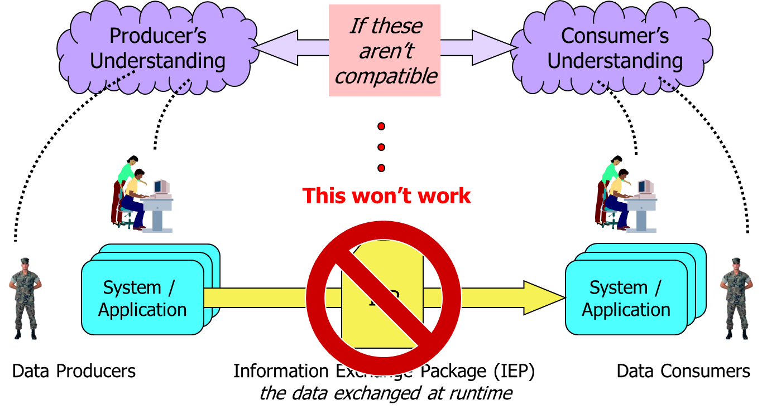
Data Interoperability Problem
The root cause of the problem is incompatible syntax, semantics and data structure.
Notes:
The data interoperability challenge is to ensure that the different developers have a compatible understanding of the data to be exchanged – because if the people on the left have a different understanding than the people on the right, then something will be broken and someone will be unhappy.
This is a complex problem involving among other things:
Multiple Data Standards
Military Standards (USMTF, VMF, TDL, Symbology, etc.)
Intelligence Community Standards (NTK, ISM, etc.)
Geospatial Standards (GML, KML, OGC, etc.)
Et al.
Lack of a coordinated data governance within the Services and across the Department
The OPEN Government Data Act directs agencies to publish their non-sensitive data in a machine-readable format and also requires agencies to hire chief data officers
Existing, incompatible operational systems, gateways, cross-domain solutions, etc.
Siloed budget and funding streams
And much more…

Slide 69
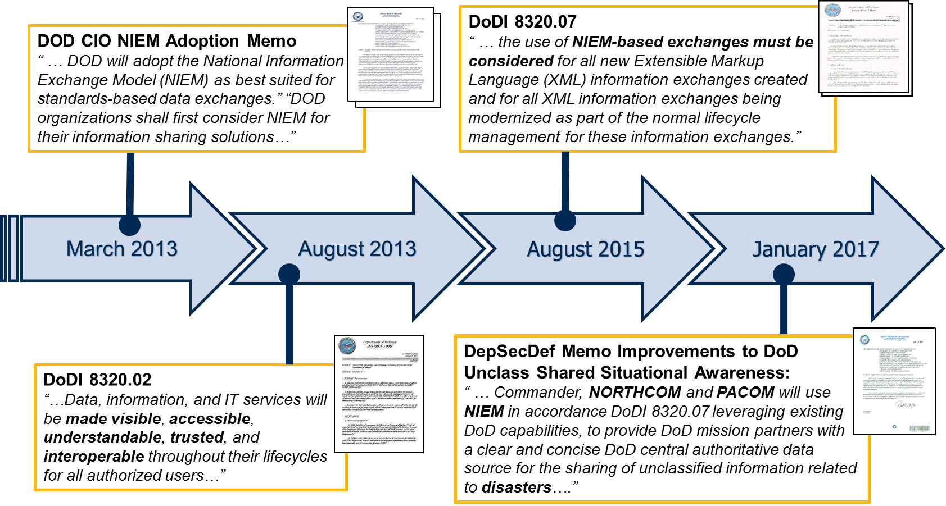
DOD Information Sharing Policy & Guidance
2003 – Net-Centric Data Strategy
Notes:
DoD Data Strategy has been consistent for 10+ years now. This policy was developed with the knowledge that data is the foundation to all warfighter decision making, and intent to mitigate the data interoperability problem. NIEM chosen by the DoD CIO and called explicitly listed in various DoD Information Sharing Policy & Guidance as the best available “standards based approach” for improving data interoperability supporting the warfighter. Best option for multiple standards-based data exchanges.
Overarching data strategy policy is a modernization and continuation of the 2003 Net-Centric Data Strategy. Data, information, and IT services (DIIS) are enablers of information sharing to the DoD. Key tenants are that DIIS must be visible, accessible, understandable, trusted and interoperable. Data, information, and IT services are trusted when they have provided sufficient pedigree and descriptive metadata for consumers to rely on them as an ADS, and they comply with applicable information assurance and cyber security policies.
DODI 8320.07, Implementing the Sharing of Data, Information, and Information Technology (IT) Services in DOD, 3 AUG 2015
standardizes use of XML across the department
establishes the Military Operations domain for semantic content.
promotes interoperability at the information exchange data level.
directs the use of NIEM for all XML information exchanges created or modernized as a part of the normal lifecycle management

Slide 70
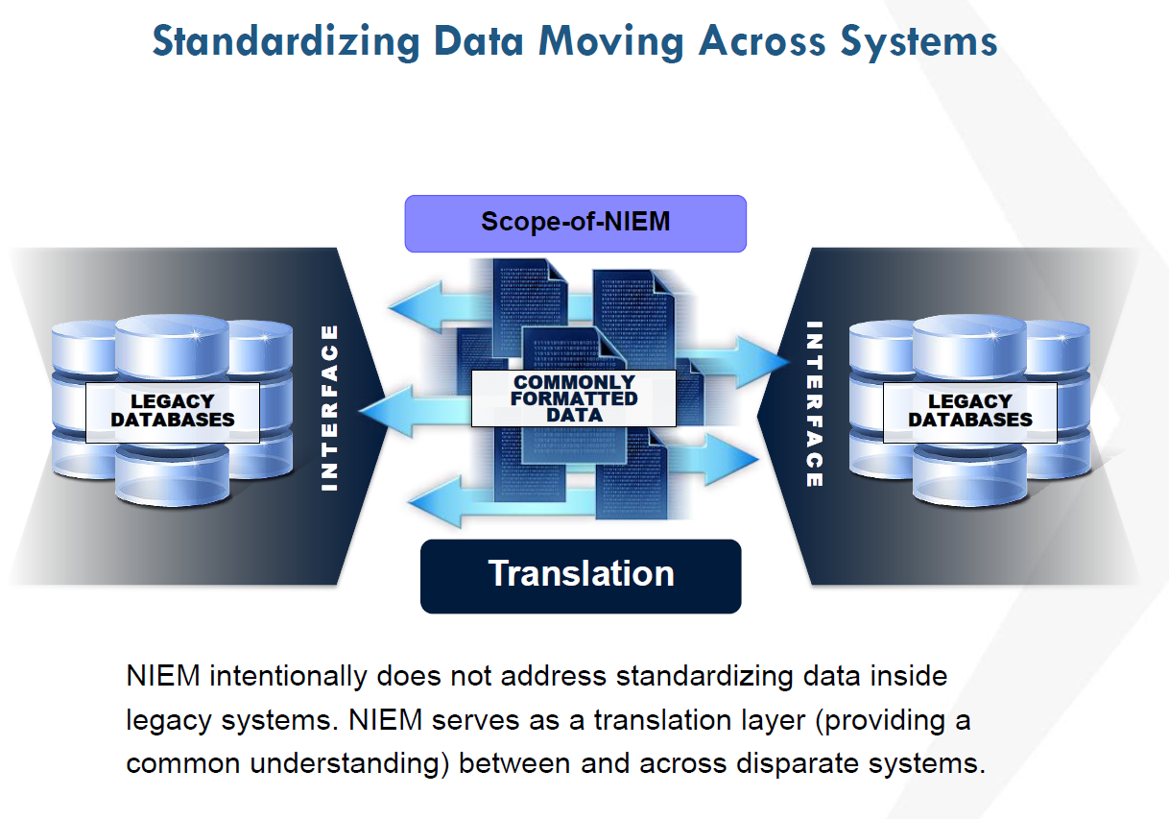
National Information Exchange Model
Warfighter data interoperability framework to enable information exchange among Combatant Commands, Service Organizations, Agencies and Mission Partners
“Whole of Government Approach” across multiple spectrums of operations
12 of 15 Federal Agencies
Internationally (Canada, Mexico, EUROPOL)
NATO
Multilateral Interoperability Programme (MIP)
Standardizes data exchange requirements
XML-based data exchanges and non-normative guidance for JSON-LD
NIEM XML- based data exchange Specifications (IESs) reuse means:
Faster mediation
Rapid implementation
Increases interoperability
Lowers development costs
Common framework for Syntax and Semantics
Notes:
National Information Exchange Model (NIEM) is a standards based approach designed to uniformly develop, centrally maintain, quickly identify and discover, efficiently reuse the enterprise wide information sharing standards and processes across multiple mission areas. NIEM is designed to develop, disseminate, and support enterprise‐wide information sharing standards and processes across the whole of the departments of Defense, Justice, Public Safety, Emergency and Disaster Management, Intelligence, and Homeland Security enterprise at all levels and across all branches of government.
1) Using XML to standardize data exchanges can be a stand-alone effort between interested parties, or within a specific COI. XML is a widely used language, and considerable resources exist to provide guidance to organizations seeking to create effective information exchanges using XML. This approach requires an established framework that provides consistent naming and design rules, and known processes for managing the building, implementation, and storing of data interface agreements.
2) The XML approach can improve information interoperability and data sharing among Command and Control (C2) information technology nodes and provide information integration among mission partners. The approach has demonstrated its ability to establish effective C2 data sharing environments without negatively impacting existing data exchanges, existing data stores, or data sharing standards.
3) A framework for using XML-based data exchanges currently exists with the National Information Exchange Model (NIEM); an approach that has been adopted for use by the US Department of Defense.

Slide 71
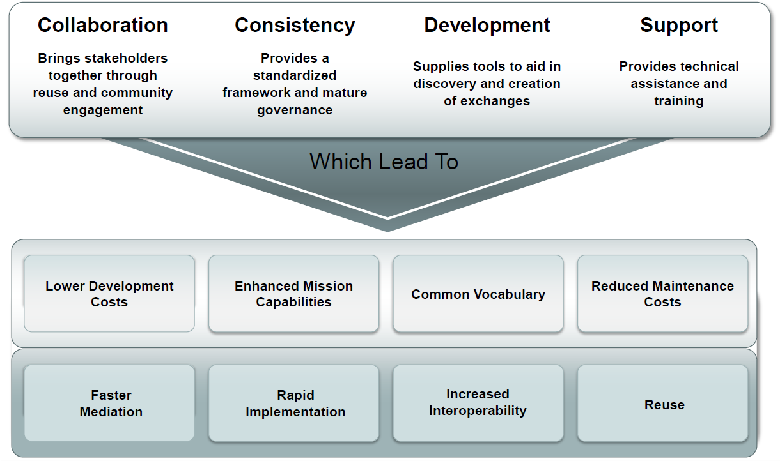
Value NIEM Offers
Notes:
Provides an agreed upon common language (e.g., syntax and semantics) for sharing data among all partners
Allows communities to come together to solve tough data sharing problems (e.g., cross COI, cross domain, etc.)
As an XML based format, NIEM allows for exchange of data from existing IT systems without affecting legacy data structures.
NIEM (XML) provides greater flexibility for modification and enhancements (e.g., JSON, binary, etc. formats from a single semantic base)
Allows reuse of exchange specifications, as well as existing successful models of enterprise adoption including web services and SOA/ESBs.
NIEM concepts and principles have consistently demonstrated these values in DoD for over 7 years:
- TIES JCTD
- TEDS JCTD
- SIRI (NATO M&S COE) – binary XML
- CWIX 16, 17
- Bold Quest 17

Slide 72
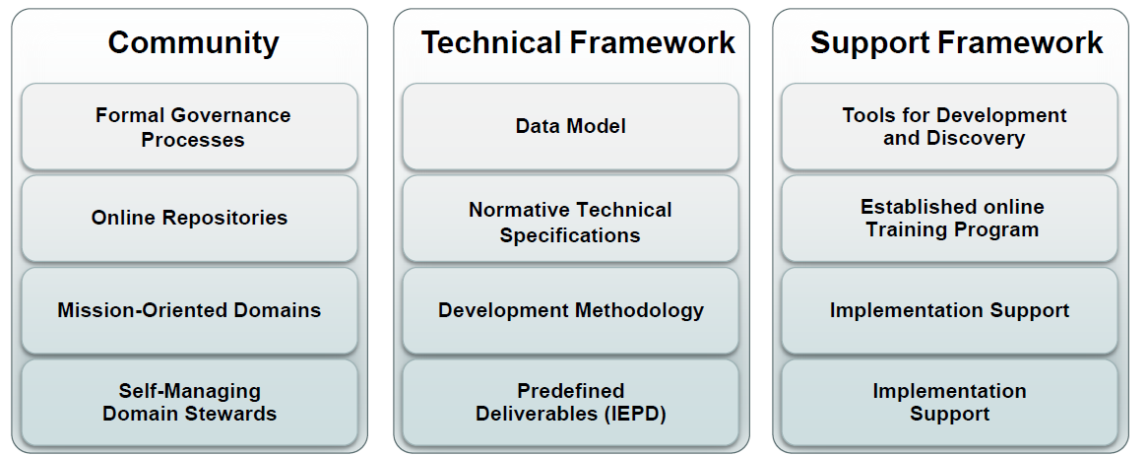
NIEM OV-1
NIEM is a community-driven, whole-of-government, standards-based approach to exchanging information. Diverse communities collectively leverage NIEM to increase efficiencies and improve decision-making.
Notes:
Build by the community over 10+ years (including: Federal, State, Local, Tribal, international stakeholders)
It’s more than just a data model
It’s more than just a pile of technical standards
Starts with: Distributed governance
Provides Normative Technical Specifications and guidance
- use to create the NIIEM reference data model
- used to develop Information Exchange Specifications (referred to as Information Exchange Package Documentation (IEPD))
Tool Support
Training Support
Implementation Support

Slide 73
Distributed governance
NIEM ESC
NIEM Executive Steering Council
NIEM PMO
Program Management Office
Executive Director
NTAC
NBAC
NIEM Technical Architecture
Committee (tech specs)
NIEM Business Architecture
Committee (data model)
Domain Stewards (14+)
User
Community
IEPD Developers
Each color differentiates an independent area of governance supported by NIEM.
Notes:
ESC – NIEM vision, and decision-maker for membership, funding, and program direction.
(Justice, DHS, HHS)
PMO – manages day-to-day program operations; facilitates collaboration with community and stakeholders in developing NIEM-based information exchange solutions. (DHS transitioning to DoD 2QTRFY18)
NBAC – guides development, harmonization, evolution, and implementation of NIEM Core data components, as well as governs processes for participating in NIEM domains.
NTAC – responsible for defining technical architecture that governs NIEM.

Slide 74
Niem technical specifications
Naming & Design Rules
(XSD/XML documents)
Reference
Constraint
Subset
Extension
IEPs (instances)
(other conformance targets?)
Schematron Rules
Specs for schemas, MPDs, and other artifacts
Wantlist
JSON Specs
Domain Update
HL Version Arch
Code Lists
Business rules
BIEC / EIEM
UML Profile
Usage Patterns
IEPD Certification
JSON Guidance
Ontology
MPD Specification:
IEM (the schema sets)
MPD Catalog with metadata
XML Catalog
Versioning
URI scheme
Change log
Master Document
Lineage
Packaging
IEPD Implementer documentation
Conformance Tgt Attribute
KEY
Done
Initialized
Conformance Specification
No spec
Notes:
Technical specifications are configuration managed by the NIEM PMO, but developed and matured by the NIEM user community based on community needs.
Mapping of the supporting NIEM technical specifications that establish the NIEM technical architecture.

Slide 75
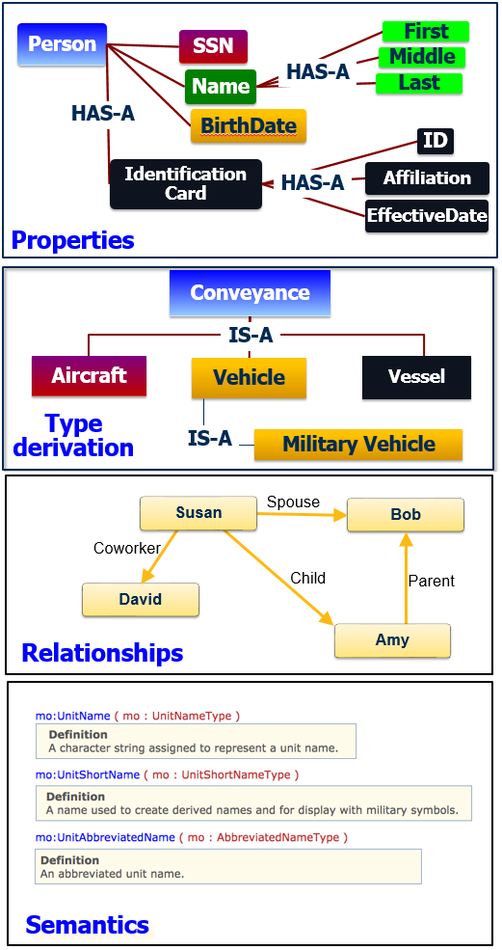
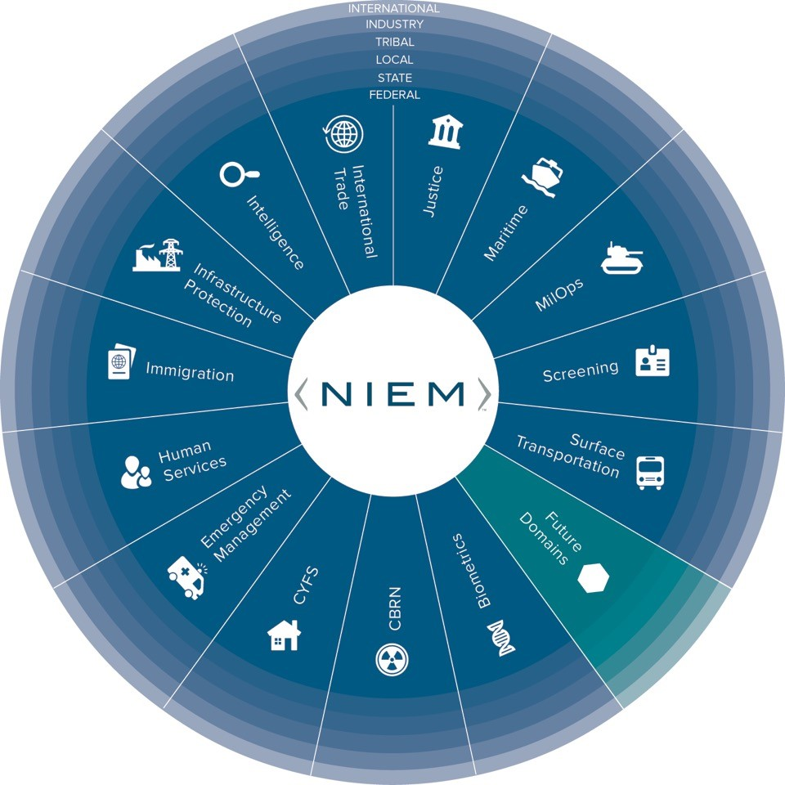
Reference Data Model
Notes:
An implementation of the NIEM technical architecture; model of reusable data components for building Information Exchange Specifications.
Defines semantics in types, properties and relationships in a Resource Description Framework (RDF).
The model is developed, managed and maintained by the NIEM PMO and community of chartered Domain Stewards.

Slide 76
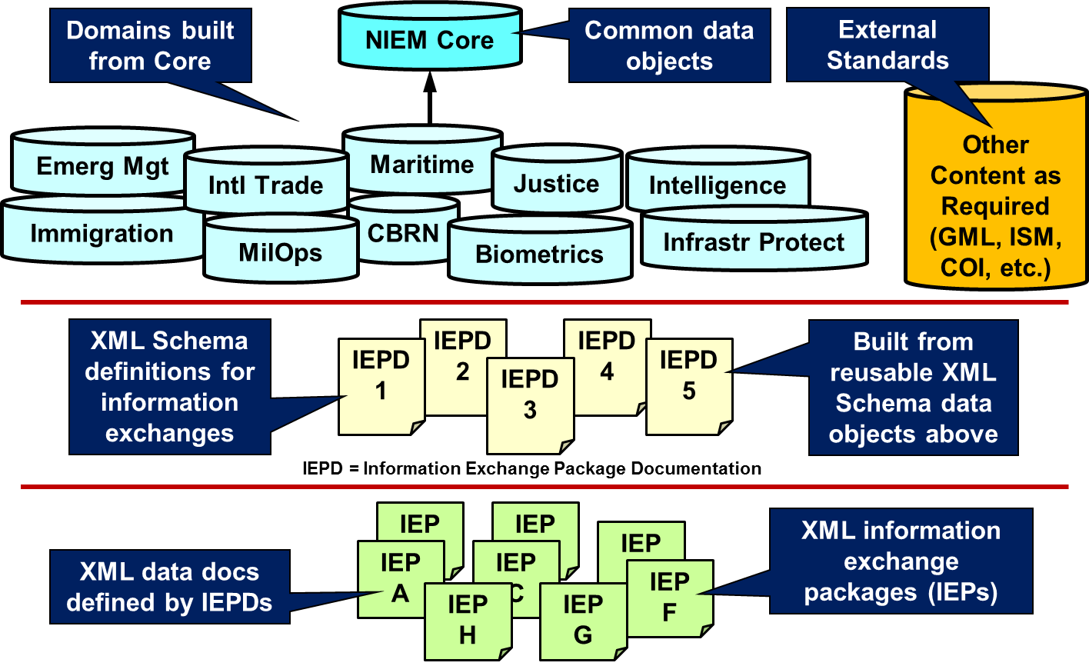
NIEM Iepd
An Information Exchange Package Documentation (IEPD) is a collection of artifacts that describe the construction and content of an information exchange
Business Rules
Information Exchange Requirements
Supporting Documentation
Notes:
An IEPD represents the culmination the NIEM technical architecture, reference data model and information exchange requirements. When completed, the IEPD represents the concrete agreement among exchange partners on how the data will be shared. It is also a discrete technical specification that may be shared, published in a registry for search and discovery, or reused as a basis for developing other IEPDs.
Core Functions of an IEPD:
Developed to provide the business, functional, and technical details of the information exchange through predefined artifacts
Created with a core set of artifacts in a prescribed format and organizational structure to allow for consistency
Designed to be shared and reused in the development of new information exchanges through the publication in IEPD repositories

Slide 77
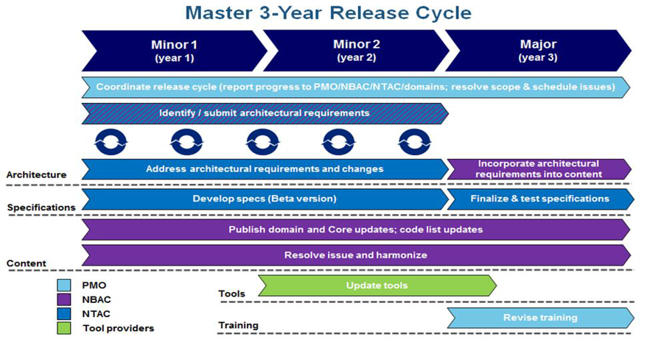
Configuration management
Notes:
High Level Version Architecture - Describes NIEM major and minor release cycles and how NIEM governance bodies update the schema documents and data components that comprise NIEM.

Slide 78
References
Starting Point: https://www.niem.gov/
Training: https://www.niem.gov/training
Technical Resources: https://www.niem.gov/techhub
Current Release: https://www.niem.gov/techhub/niem-model/current-release
IEPD Developer Resources: https://www.niem.gov/techhub/iepd-resources
Implementation Support: https://niem.github.io/
Tools: https://www.niem.gov/tools-catalog
Joint Staff J6 POC: ralph.m.oconnell.civ@mail.mil; mark.r.dotson.ctr@mail.mil

